Slide 1
Introduction to Software Testing
420-E301 Systems III
References:
Ron Patton. Software Testing. Second Edition. 2006
Crispin & Gregory. Agile Testing, 2010

Slide 2
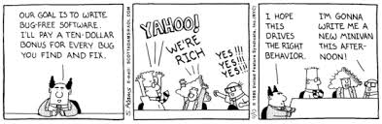

Slide 3
What is a Bug?
The software doesn’t do something that the product specification says it should do.
The software does something that the product specification says it shouldn’t do.
The software does something that the product specification doesn’t mention.

Slide 4
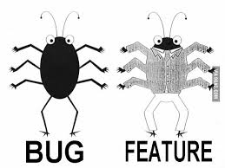
What Else is a Bug?
The software doesn’t do something that the product specification doesn’t mention but should.
The software is difficult to understand, hard to use, slow, or – in the software tester’s eyes – will be viewed by the end user as just plain not right.

Slide 5
Terms for Software Failures
Most Generic | Most Severe Sounding | Unintended Sounding
Problem Error Bug Glitch | Defect Fault Failure | Incident Anomaly Variance Inconsistency Feature

Slide 6
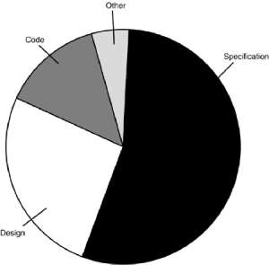
Why Do Bugs Occur?
~15 billion lines of code written a year
If ½ of 1% have errors, 75 million new bugs introduced every year
Main cause is the specification
May not exist
Not thorough enough
Constantly changing
Not communicated to development team

Slide 7
Famous Bugs
September 2006
Patch to OpenSSL breaks random number generator, not reported until April 2008.
Every key generated between those times is compromised (along with all the data).
Notes:
In order to fix a warning issued by Valgrind, a maintainer of Debian patched OpenSSL and broke the random number generator in the process. The patch was uploaded in September 2006 and made its way into the official release; it was not reported until April 2008. Every key generated with the broken version is compromised, as is all data encrypted with it, threatening many applications that rely on encryption such as S/MIME, TOR, SSL or TLS protected connections and SSH.

Slide 8

Famous Bugs
January 2009 – Google's search engine notified users that every web site world wide was potentially malicious, including its own
Notes:
http://www.theregister.co.uk/2009/01/31/google_malware_snafu/

Slide 9
Cost of Bugs
2002 Computer World study estimated
the cost at $60 Billion/year
Notes:
Estimated that better testing could reduce the cost by 1/3 ($20 billion)
Cause was a counter that went from 2^32 down to 0 in milliseconds (50 days) sending out a signal to voice communication command; supposed to reboot every 30 days so it should not have been a problem; someone did not reboot; backup system went down as soon as it was booted
Blackout – deadlock, everyone busy so all tried to switch. If one system had been given precedence, the deadlock would not have occurred – cost $6 - $10 billion

Slide 10
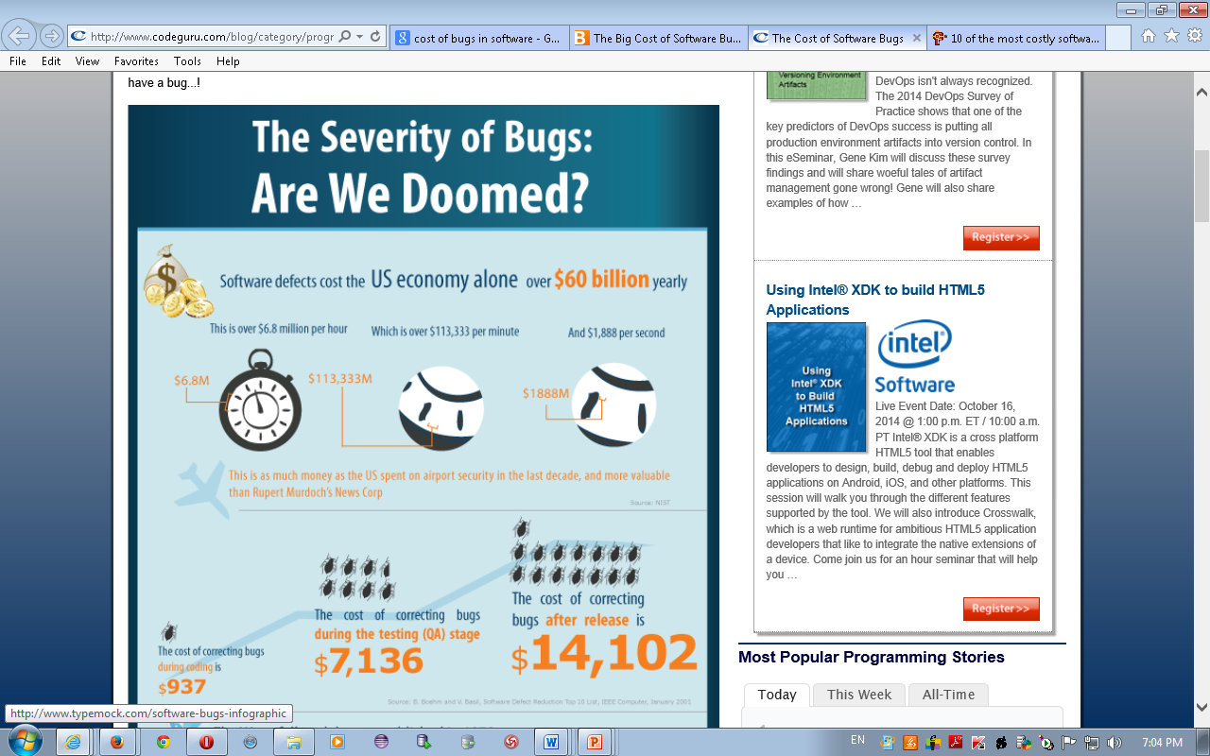
Notes:
http://www.codeguru.com/blog/category/programming/the-cost-of-bugs.html

Slide 11
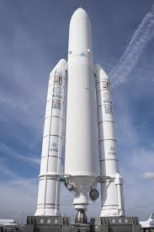
Cost of Bugs
The European Space Agency's Ariane 5 Flight 501 was destroyed 40 seconds after takeoff (June 4, 1996).
The US$1 billion prototype rocket self-destructed due to a bug in the on-board guidance software.
Notes:
Estimated that better testing could reduce the cost by 1/3 ($20 billion)
Cause was a counter that went from 2^32 down to 0 in milliseconds (50 days) sending out a signal to voice communication command; supposed to reboot every 30 days so it should not have been a problem; someone did not reboot; backup system went down as soon as it was booted
Blackout – deadlock, everyone busy so all tried to switch. If one system had been given precedence, the deadlock would not have occurred – cost $6 - $10 billion

Slide 12

Cost of Bugs: Toyota
In 2010, Toyota recalled 400 000 hybrid cars including the Prius line.
The problem was a software glitch, which caused a lag in the anti-lock-brake system.
Cost: 3 Billion dollars!
Notes:
When Toyota recalled more than 400,000 of its hybrid vehicles in 2010, it wasn't because of a mechanical issue. The cars, including Toyota's Prius line, had a software glitch, which would cause a lag in the anti-lock-brake system. The news came at a time when Toyota had come under scrutiny for safety issues related to physical defects in millions of other cars it had made. Class-action lawsuits resulting from those recalls, including the software glitch, were estimated to cost Toyota as much as $3 billion, according to an estimate by the Associated Press.

Slide 13
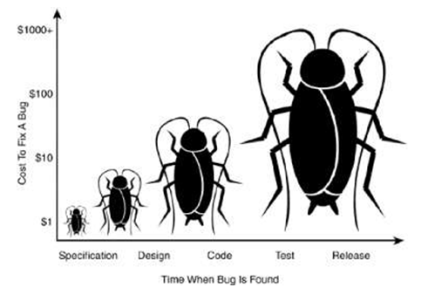
Cost of Bugs
The cost of bugs increases tenfold as time increases.

Slide 14
Testers and Developers
Rule of thumb for ratio:
#testers
#developers
Notes:
Depends on the complexity of the product
General applications 1:2 (http://www.joelonsoftware.com/articles/fog0000000067.html)
Microsoft 1:1 (depends on the amount of automation)
VLSI/ASIC design 2:1 (you’re committing to hardware)

Slide 15
Role of Software Tester
Goals of software tester:
find bugs,
find them as early as possible,
make sure they are fixed.
Notes:
Traits
Explorer – not afraid to go into unknown situations
Troubleshooters – be able to figure out why something doesn’t work
Relentless – keep trying; see a bug that is hard to replicate, attempt to find it again
Creative – don’t just test the obvious, be creative, off-the-wall with some of your testing
Perfectionists (mellowed) – strive for perfection but know that it is impossible
Good judgement – decisions on what to test, how long it will take and if problem they find is really a problem
Tactful – tell programmers their baby does not work
Persuasive – convince people on importance of fixing bugs

Slide 16
Testing in Agile
Test Driven Development (TDD)
Tests are written first (acceptance tests)
Testing is performed all the way through the development cycle.
Testers are involved from the start.
In an Agile world, testers are the most valuable member of the team.

Slide 17
Agile Testing Philosophy
Test early; Test often

Slide 18
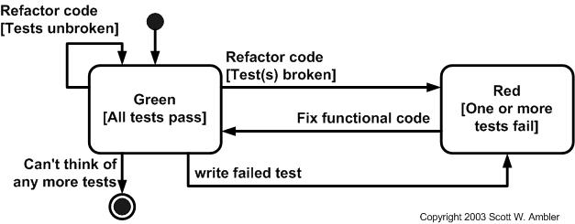
Test Driven Development (TDD)
Requires testing framework

Slide 19
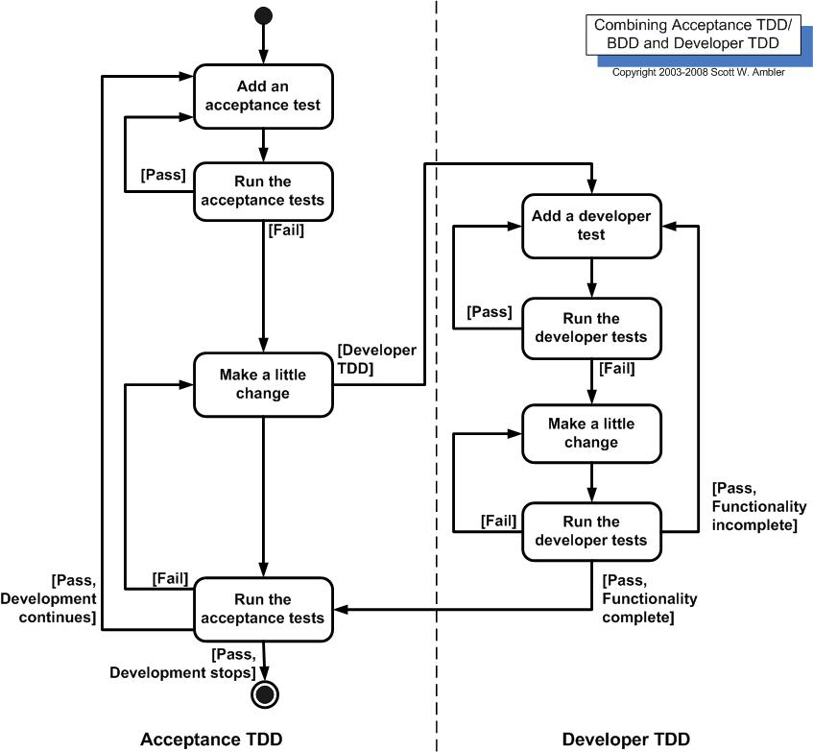

Slide 20
Testing Considerations
Testing is risk-based
Testing cannot show that there are no bugs
The more bugs you find, the more bugs there are
“Pesticide Paradox” – code becomes immune to testing
Not all bugs will be fixed
Notes:
Software testing is a risk-based exercise
reduce possible tests into manageable set and make risk based decisions on what is important to test and what’s not
Testing cannot show that bugs do NOT exist
Cannot guarantee that there are no more bugs, e.g. exterminator
The more bugs you find, the more bugs there are
Bugs tend to come in groups - like real bugs
The Pesticide Paradox
Code becomes immune to testing
Write new and different test cases to exercise different parts of the program
Not all the bugs you find will be fixed
Not enough time
Not really a bug
Too risky to fix – known bug may be better than risk of new, unknown bugs
Not worth fixing

Slide 21
Terms – Verification vs Validation
Verification – process confirming that software meets its specification
Validation – process confirming that software meets user requirements
Something may meet specification (verification), but not original requirement (validation)

Slide 22
Terms: Quality vs Reliability
Quality – breadth of features, speed, performance, etc
Reliability – one aspect of quality – how often product crashes

Slide 23
Triangle Testing Problem
Reference:
http://www.testingeducation.org/conference/wtst3_collard4.pdf

Slide 24
Triangle Problem
A software program reads three input data values that represent the three lengths of the sides of a triangle.
The program displays a message which states whether the triangle is:
- scalene (i.e., no two sides are equal),
- isosceles (two sides equal) or
- equilateral (all sides equal).

Slide 25
Triangle Problem
With a partner, write the set of test cases to test the triangle problem.

Slide 26
Number of Test Cases?
Ross Collard 4
Kent Beck 6
Robert Binder 65
Paul Jorgenson 185
This sounds like a bad joke – ask four different experts, get four different answers which range from four to 185 test cases – and four consulting bills. - Ross Collard

Slide 27
What is the Right Answer?
Depends on the context!
Can only be answered in terms of perceived risk in the situation and amount of effort we are willing to expend to avoid that risk.
Testing always involves a trade-off between the risk and economics.
You first need to know the context before you can solve the problem.

Slide 28
What is the Right Answer?
The software for the NASA space shuttle computes the shape of triangles as part of its orbital navigation
Most image processing software works with polygons, of which triangles are the simplest form.
The NASA mission is life-critical: if the orbital navigation is wrong, the consequences could be severe.

Slide 29
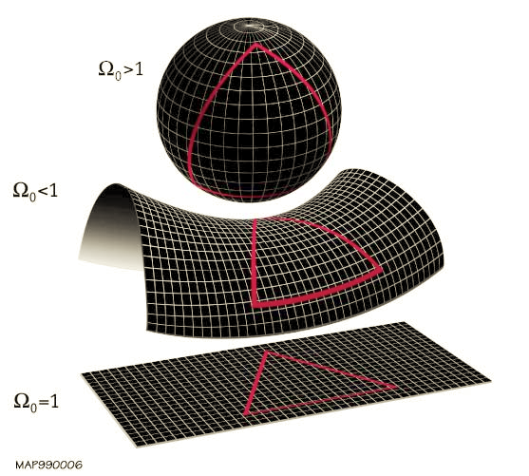
What is the Right Answer?
The triangles computed on the space shuttle are curved—they are based on the shape of the earth’s surface. Most participants in the triangle experiments assume a flat surface without really thinking about it.

Slide 30
Myers’ Answer to Triangle Problem
Test case for a valid scalene triangle
Test case for a valid equilateral triangle
Three test cases for valid isosceles triangles (a=b, b=c, a=c)
One, two or three sides has a zero value
One side has a negative value
Sum of two numbers equals the third (e.g. 1,2,3) is invalid because it is not a triangle (tried with 3 permutations: a+b=c, a+c=b, b+c=a)
Sum of two numbers is less than the third (e.g. 1,2,4) (3 permutations)
Non-integer
Wrong number of values (too many, too few)

Slide 31
Lessons from the Triangle Problem
Complete testing is not possible.
Intuitive approaches to testing often miss important test cases. Intuitive testers are often over-confident.
Effective testing depends on understanding the context of the problem.
Testing is a trade-off between risk and economics. - Ross Collard

